Slide 1

ASHOKA WOMEN’S ENGINEERING COLLEGE
“AI-based Nutrition Recommendation System”
By:
A.Bhavya 222t1a0502
J.Vaishnavi 222t1a0565
B.Deepthi 222t1a0520
E.Shirisha 222t1a0542
DEPT CSE
Project Guide:
Dr.T.Sreelatha MCA,M.Phil,M. Tech, PhD
Associate Professor

Slide 2

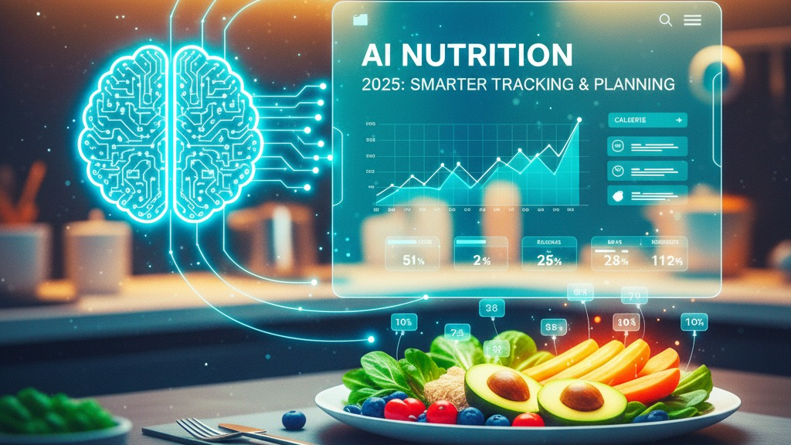
“AI-based Nutrition Recommendation System”

Slide 3
OUTLINES
ABSTRACT
INTRODUCTION
PROBLEM STATEMENT
OBJECTIVE
EXISTING SYSTEM
DISADVANTAGES OF EXISTING SYSTEM
PROPOSED SYSTEM
ADVANTAGES OF PROPOSED SYSTEM
SYSTEM REQUIREMENTS(HARDWARE & SOFTWARE REQUIREMENTS)
ALGORITHMS USED
METHODOLOGY
WORKING OF THE PROJECT(INTRODUCTION,CODE,RESULT)
CONCLUSION
FUTURE SCOPE
APPLICATIONS
REFERENCE

Slide 4
ABSTRACT
The AI-Based Nutrition Recommendation System is developed to help people choose healthy food based on their personal health information. Many people follow general diet plans that may not be suitable for their body.
This system uses Artificial Intelligence (AI) and Machine Learning to analyze user details such as age, height, weight, BMI, lifestyle habits, and health conditions. Based on this information, the system recommends a suitable diet plan for each user.
The main goal of this system is to provide personalized nutrition suggestions that help users maintain a balanced diet and improve their health. The system can also update recommendations when user information changes. This makes the system smarter and more helpful than traditional diet planning methods.

Slide 5
INTRODUCTION
Nutrition is the process of consuming food that provides essential nutrients required for the body to function properly and maintain good health.
Nowadays, many people want to live a healthy life, but they do not know what food is best for their body. Different people need different types of food depending on their age, weight, health condition, and lifestyle.
This project, AI-Based Nutrition Recommendation System, uses Artificial Intelligence (AI) to help people choose the right food. The system studies user health information and suggests a suitable diet plan. This helps users maintain a balanced diet and improve their health.

Slide 6
PROBLEM STATEMENT
Traditional diet plans are usually the same for everyone. They do not consider individual health conditions.
For example:
A diabetic person should avoid sugary food.
A person who wants to lose weight needs a low-calorie diet.
A fitness person may need a high-protein diet.
Because traditional systems do not consider these factors, they may give incorrect or unhealthy suggestions.

Slide 7
OBJECTIVE
The main objectives of this project are:
To develop an AI-based system for nutrition recommendation.
To analyze user health data such as age, BMI, and lifestyle.
To provide personalized diet suggestions.
To promote healthy eating habits.
To improve overall health through proper nutrition guidance.

Slide 8
EXISTING SYSTEM
In the existing system, diet plans are mostly general diet charts or advice from books and websites.
Characteristics of existing systems:
Same diet plan for many people
No analysis of personal health data
Manual diet planning
No automatic updates

Slide 9
DISADVANTAGES OF EXISTING
The existing system has several problems:
It does not give personalized diet plans.
It cannot adjust when the user's health changes.
It may suggest foods that are not suitable for some diseases.
It does not learn from new data or user feedback.
Because of these limitations, people may follow incorrect diet plans.

Slide 10
PROPOSED SYSTEM
To solve these problems, this project proposes an AI-Based Nutrition Recommendation System.
In this system:
The user enters personal details like age, height, weight, BMI, and health conditions.
The system analyzes the data using Machine Learning algorithms.
Based on this information, the system suggests a suitable meal plan.
The system can also update recommendations when user information changes.

Slide 11
ADVANTAGES OF PROPOSED SYSTEM
The proposed system provides many benefits:
Personalized diet recommendations
Accurate analysis using AI
Real-time updates
Easy to use web interface
Supports many users simultaneously
It acts like a smart digital nutrition assistant.

Slide 12
ALGORITHMS USED
This project uses the Gradient Boosting Classifier algorithm.
This algorithm:
Combines multiple decision trees
Improves prediction accuracy
Learns from previous errors
Works well with complex health data
It helps the system make accurate diet recommendations.

Slide 13
METHODOLOGY
The project follows several steps:
Data Collection
User information such as:
Age
Weight
Height
BMI
Health conditions
Lifestyle habits
is collected.
Data Preprocessing
The data is cleaned by:
Removing errors
Handling missing values
Normalizing and encoding features

Slide 14
METHODOLOGY
Model Training
Machine learning models are trained using the dataset to learn patterns between health data and diet plans.
Prediction
The trained model predicts the best diet plan for each user.
Web Application
The system is deployed using Flask, allowing users to interact with it through a web interface.

Slide 15
SOFTWARE REQUIREMENTS
Hardware Requirements
Computer or Laptop
Minimum 4 GB RAM
Minimum 500 GB Hard Disk
Internet connection
Software Requirements
Operating System: Windows
Programming Language: Python
Framework: Flask
Libraries: Pandas, NumPy, Scikit-learn
Development Tools: VS Code / Jupyter Notebook

Slide 16
WORKING OF THE PROJECT
The working of the AI-Based Nutrition Recommendation System includes the following steps:
User Input
The user enters personal health information such as age, height, weight, BMI, lifestyle habits, and health conditions.
Data Processing
The system processes the input data and prepares it for machine learning analysis.
Machine Learning Analysis
The trained machine learning model analyzes the user data and identifies the most suitable nutrition plan.
Diet Recommendation
Based on the analysis, the system suggests healthy food options and meal plans for the user.
Result Display
The recommended diet plan is displayed to the user through the web application interface.

Slide 17
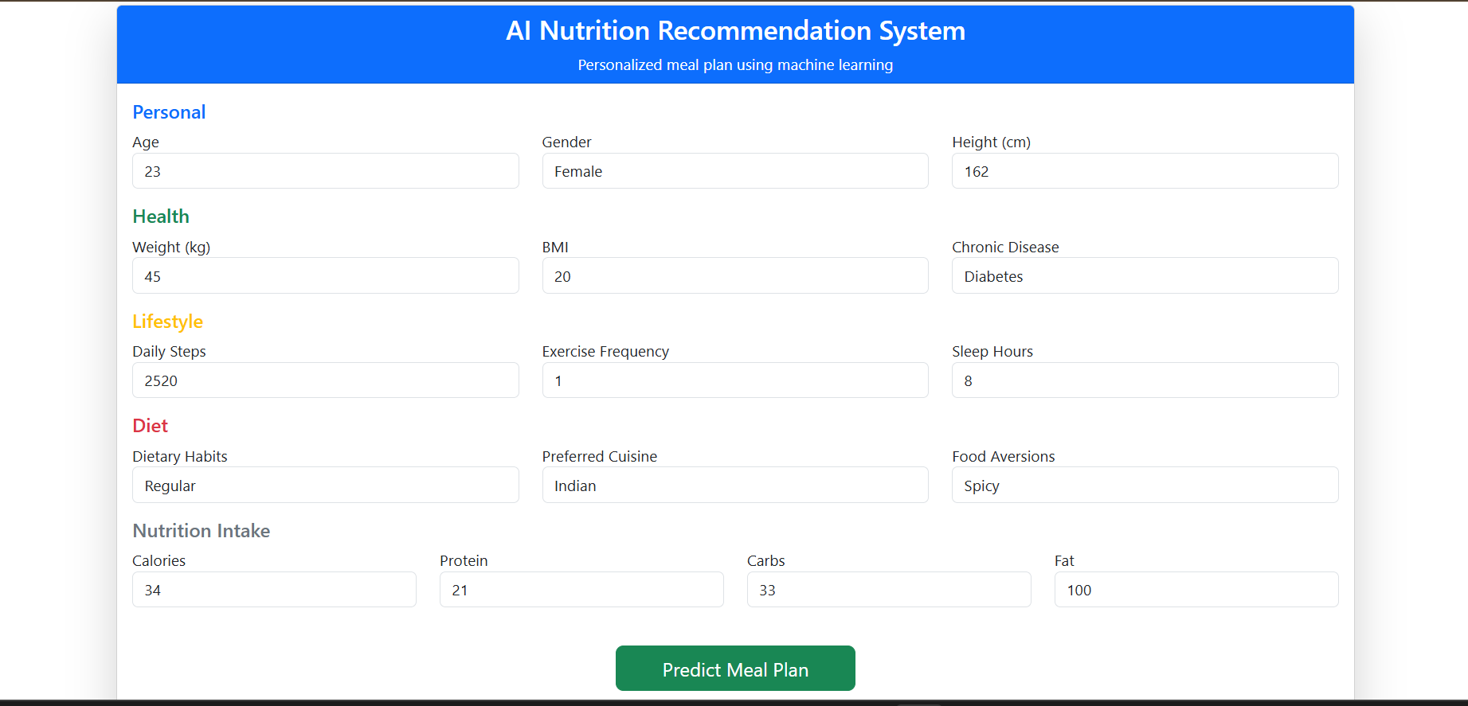
WORKING OF THE PROJECT

Slide 18
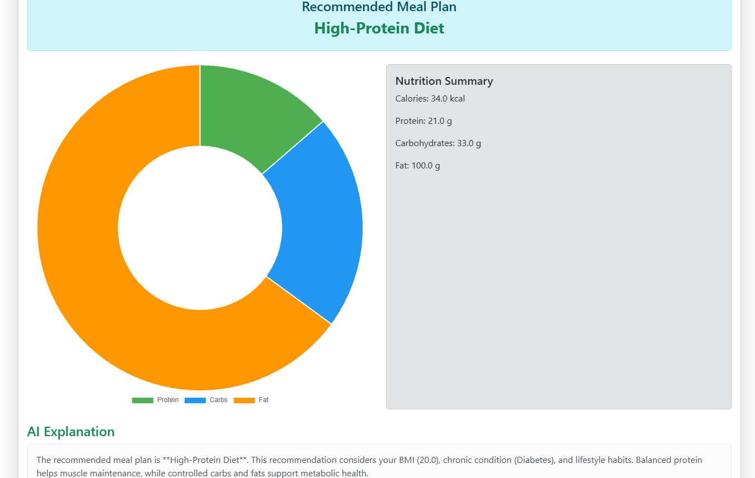
WORKING OF THE PROJECT

Slide 19
APPLICATIONS
This system can be used in many areas:
Healthcare and hospitals
Fitness and wellness centers
Diet planning for patients
Personal health management
Health mobile applications

Slide 20
CONCLUSION
The AI-Based Nutrition Recommendation System helps people choose the right food according to their health conditions. By using machine learning techniques, the system can analyze user data and provide personalized diet suggestions.
This helps users maintain a healthy lifestyle and balanced diet. The system is efficient, scalable, and can support many users.

Slide 21
FUTURE SCOPE
In the future, the system can be improved by:
Using deep learning algorithms
Connecting with fitness bands and smartwatches
Providing real-time health monitoring
Creating mobile applications
Improving diet recommendations using user feedback
These improvements will make the system more intelligent and useful.

Slide 22
REFERENCES
Some references used in this project include research papers and articles related to:
AI-Based Personalized Nutrition Systems
Machine Learning in Healthcare Applications
Food Recommendation Systems using Artificial Intelligence
Nutrition and Health Management Research Papers
Example sources:
IEEE Research Papers on AI in Healthcare
Google Scholar Research Articles
Machine Learning and Nutrition Recommendation Studies

Slide 23
THANK YOU
….

